Slide 1
HANSONG
LS2 No Display repair report

Slide 2
There are two types phenomenon according to the crushed differences.
- 1) no main display at all
- 2) logo showed in a few sec
For the first error : No main display at all due to SD card crushed, we did many tests to reproduce this failure, we can't reproduce it, we can't fix the root cause right now, but we found a workaround.
For the second error : which can be fixed via firmware.

Slide 3
The corresponding analysis of the first problem is as follows:
1. Happen in module
The following devices have such issues so far:
H87LS2P0009 H87LS2P0021
H89LS200301 H89LS200432
H89LS200468 H89LS200534
H89LS200562 H89LS200665
H89LS200930

Slide 4
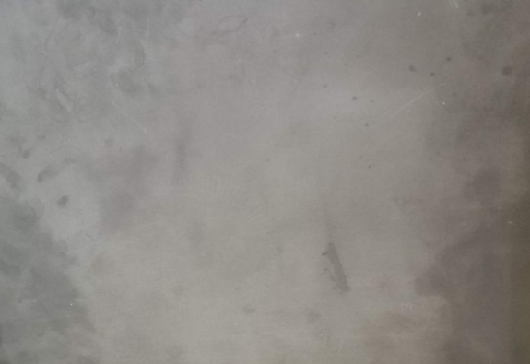
2.Phenomenon
After power on, no main display at all

Slide 5
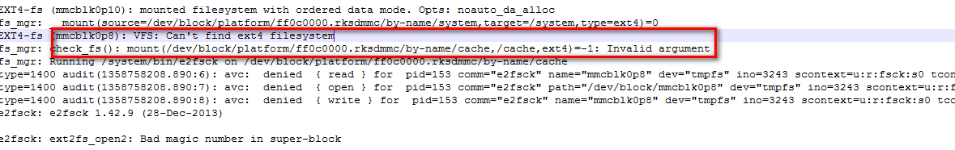
3. Reason
We've looked at the startup logs for these modules, and the commonality is that the Android OS won't boot.
We further analyzed and concluded that OS could not start properly due to the failure of system /cache or /metadata partition to mount successfully.
Here is a screenshot of the analysis:

Slide 6
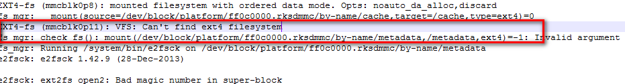
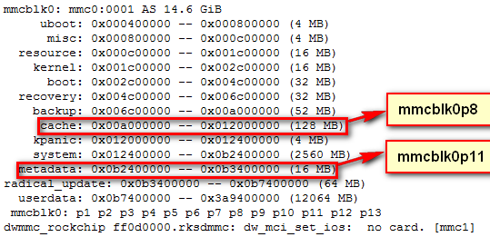
The corresponding block area is shown below:

Slide 7
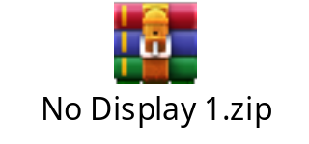
As can be seen from the above, it is /cache and /metadata partition that cause the damage.
We intercepted the system log file, please check in attachment.

Slide 8
4、solution
At present, we have not found the root cause of this problem. We can‘t solve the problem at the root. However, according to the log information of the machine where the error occurred, we can see that both /cache and /metadata partition mount failed.
So we did a workaround to fix that, When we detect a partition mount error, we will reformat the partition and the system will start again. So far the test results are good and no other problems have been caused.

Slide 9
HANSONG
The corresponding analysis of the second problem is as follows:
1. Happen in module
There are 2 modules have this issue so far:
H89LS200920
H89LS200564

Slide 10
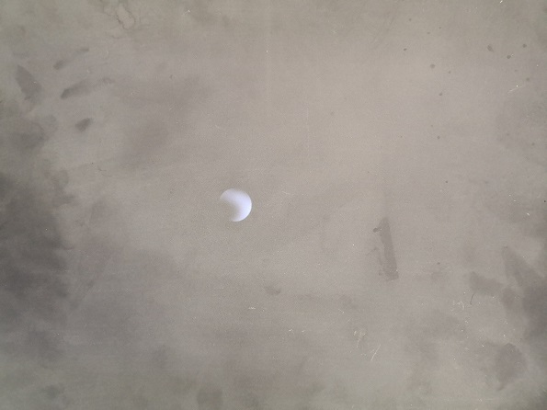
HANSONG
2.Phenomenon
After power on, stay in boot animation, can not enter Unity app.

Slide 11
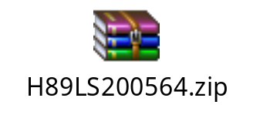

HANSONG
3. Reason
We found in these failed module,
There is no available Unity program in /data/app/com.lyricspeaker.lyricsync/, if so LS2 system will stop in boot animation.
We also have dump these module’s file stored in /data/app, please check in attachment.

Slide 12
HANSONG
4. Reprodce
We do sudden power off test during Unity upgrading, 57 times is ok;
We do sudden plug out sd card test during Unity upgrading, 43 times is ok;

Slide 13
HANSONG
5. Recovery
1). Principle
Add a backgroup process to monitor Unity program, if it is not started, to start it by reinstall.
In android OS, system owned apks are stored into /system/app/;
User downloaded and owned apks are stored into /data/app/;
System owned apks updated will also stored into /data/app/;
So, like Unity, if there is nothing in /data/app/com.lyricspeaker.lyricsync, we can use pm unintall to clean upgrade recording, then do reinstall, so the Unity apk will be ok in /data/app/com.lyricspeaker.lyricsync.

Slide 14
HANSONG
5. Recovery
2). Detail code
if [ -z "$(ps | grep "lyricsync")" ];then
pm uninstall com.lyricspeaker.lyricsync
rm -rf /data/app/apps.yaml
reboot
fi

Slide 15
Announcements：
Because we modified the code of android system layer, the changes will take effect in the android firmware, there is no way to conduct the firmware of OTA android system at present, We will remake the system image for later production。

